Slide 1
Healthy cooking and eating
Jessica Hildebrandt, MS, RD
Children’s Hospital Colorado

Slide 2
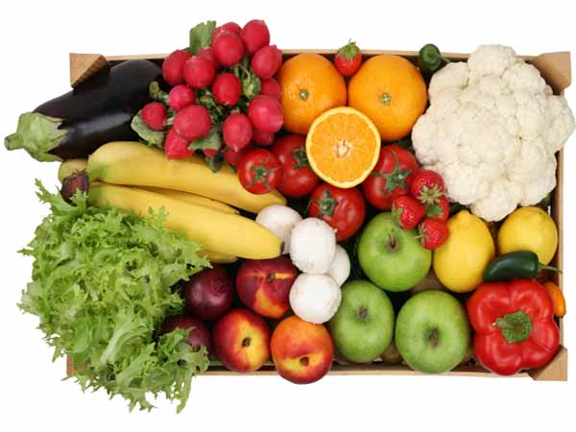
Welcome!
Objectives:
Review Current Nutrition Recommendations:
  Dietary Guidelines
  USDA Plate Model
Discuss ways to improve nutrition of foods/recipes when cooking/preparing foods.
Provide Meal/Snack Ideas
Demonstrate a recipe

Slide 3

Key Recommendations:
1. Consume a healthy eating pattern that accounts for all foods and beverages within an appropriate calorie level.

Slide 4
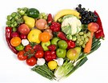
A Healthy Eating Pattern Includes:
2. A variety of vegetables
3. Fruits
from all the subgroups:
  dark green
  red and orange
  legumes (beans and peas)
  starchy, (corn, potatoes- sweet potatoes)
  Other
Especially whole fruits

Slide 5
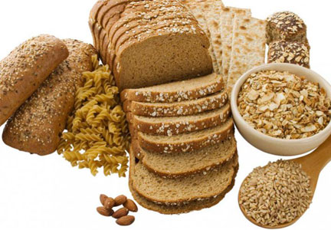
A Healthy Eating Pattern Includes:
4. Grains
  At least ½ of which are whole grains.

Slide 6
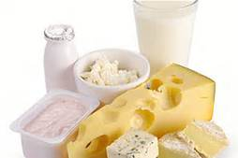
A Healthy Eating Pattern Includes:
5. Fat-free or low-fat dairy
Including
  Milk
  Yogurt
  Cheese
  And/or fortified soy beverages

Slide 7
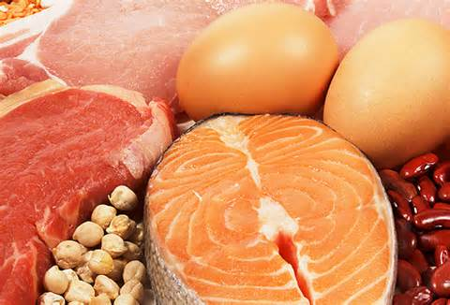
A Healthy Eating Pattern Includes
6. A variety of protein foods:
Seafood
Lean meats and poultry
Eggs
Legumes (beans, lentils and peas)
Nuts, seeds
Soy products

Slide 8
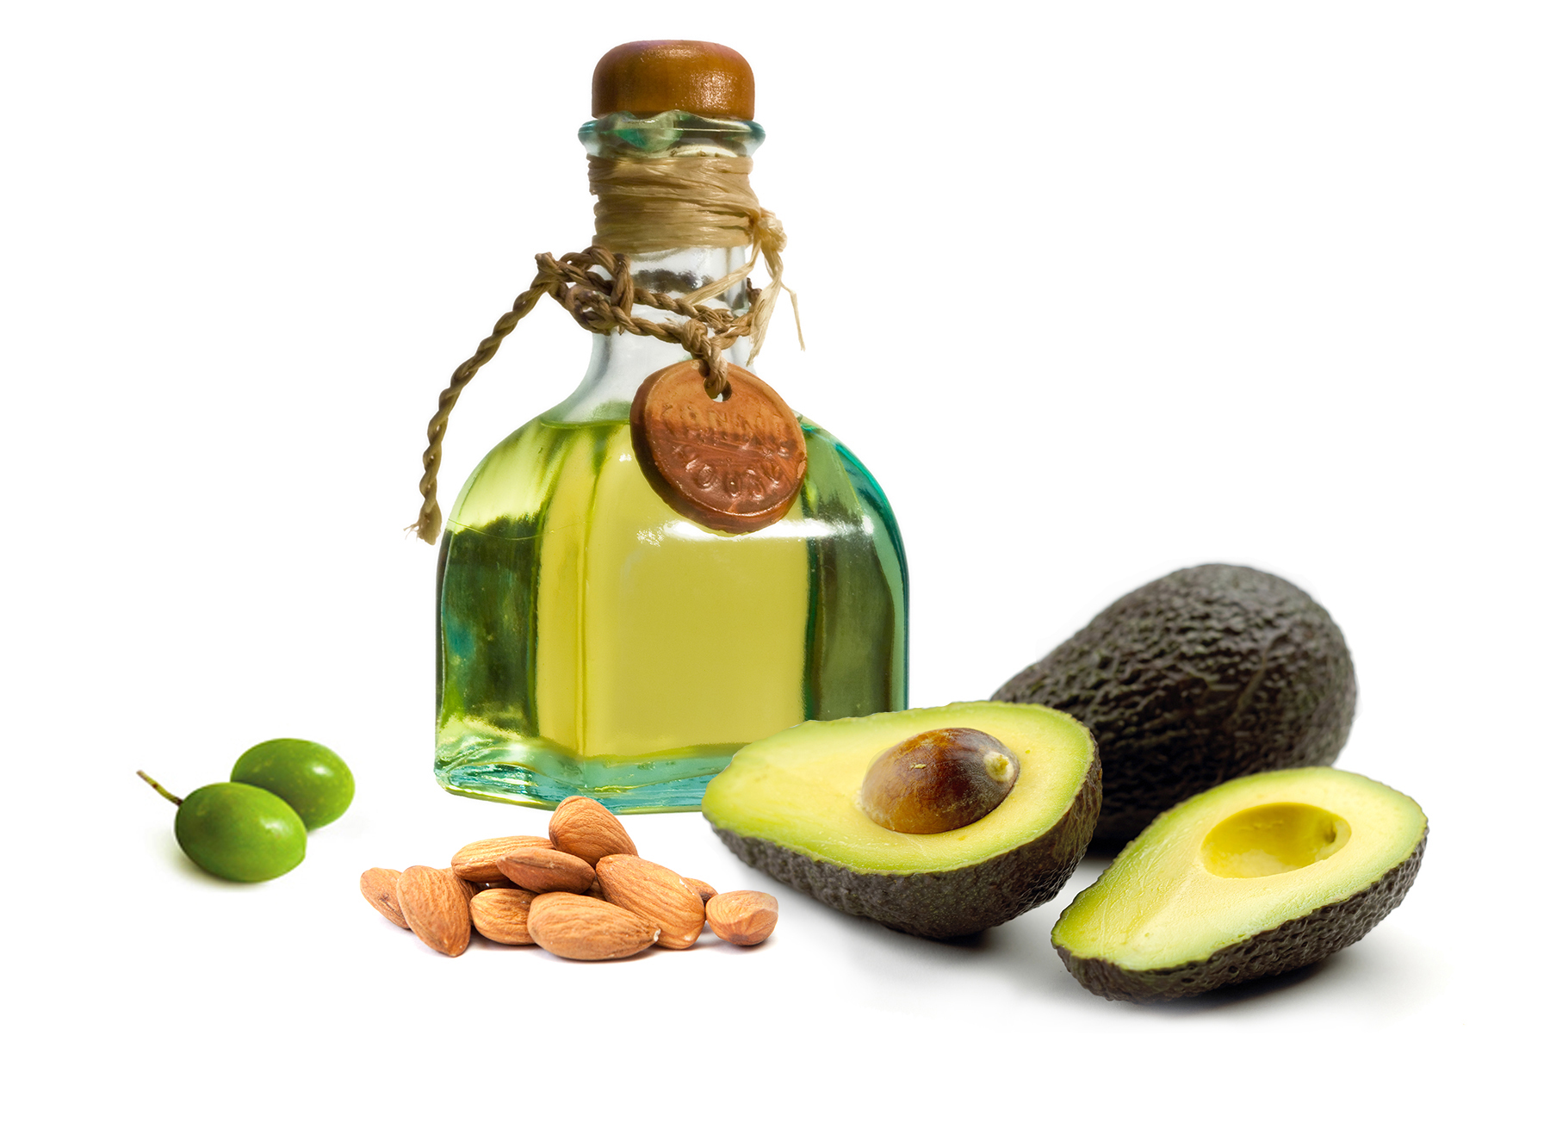
A Healthy Eating Pattern Includes
7. Oils:
Unsaturated
  Canola
  Olive
  Peanut, grapeseed, soy
  Fish
  Nuts
  Avocados
  Olives (high in sodium)

Slide 9

A Healthy Eating Pattern Limits:
8.Saturated Fats and Trans Fats
Butter, whole milk, meats that aren’t lean, fast foods, pastries etc.
10% daily calories:
  2,000 calories per day
  = 22 grams/day
  Chipotle chicken salad bowl with brown rice, black beans, grilled veggies, cheese, sour cream, guacamole, vinaigrette
  24 grams (also 1,300 cals.)

Slide 10

A Healthy Eating Pattern Limits:
9. Added Sugars
Soda, chocolate milk, snack foods, cereals, granola bars, yogurts, candy, desserts etc.
10% daily calories:
  2,000 calories/day
  = 200 calories or 50 grams
  1-20 oz. bottle of mountain dew has 77 grams

Slide 11

A Healthy Eating Pattern Limits:
Sodium
Added salt, seasonings, processed foods, canned foods, snack foods, frozen foods
2,300 milligrams/day
  1 teaspoon
Chipotle chicken salad bowl with brown rice, black beans, grilled veggies, cheese, sour cream, quac., vinaigrette
  2, 930 milligrams

Slide 12
USDA Plate Model
Eat Right with MyPlate
Key Messages

Slide 13
Make ½ your plate fruits and veggies
Focus on whole fruits.
Choose whole fruits –fresh, frozen, dried or canned in 100% juice.
Avoid those with added sugars.
2 cups/day (2,000 calorie diet)

Slide 14
Make ½ your plate fruits and veggies
Vary your veggies.
Fresh (seasonal)
frozen or
canned vegetables
Prepare in healthful ways: steamed, sautéed, roasted or raw
2.5 cups/day (2,000 calorie diet)

Slide 15
Make half your grains whole
Look for whole grains listed first or second on the ingredients list – try oatmeal, popcorn, whole-grain bread and brown rice.
  48 grams (~ 3 servings/day)
  1 oz. whole grain bread
  ½ cup whole grain pasta/rice/quinoa etc.

Slide 16
Vary your protein routine.
Mix up your protein foods to include seafood, beans, lentils and peas, unsalted nuts, nut butters, seeds, soy products, eggs, and lean meats and poultry.
Adults 5-6 oz. /day
Fish 8 oz. /week

Slide 17
Move to low-fat or fat-free milk or yogurt.
Choose fat-free milk, yogurt and fortified soy beverages (soy milk) to cut back on saturated fat.
Replace sour cream, cream and regular cheese with low-fat yogurt, milk and cheese.
3 servings/day
  8 oz. milk or yogurt
  1 oz. cheese
  ½ cup cottage cheese

Slide 18
Drink and eat less sodium, saturated fat and added sugars.
Use the Nutrition Facts label and ingredients list to limit items high in sodium, saturated fat an added sugars.
Choose vegetable oils instead of butter and oil-based sauces and dips instead of ones with butter, cream or cheese.
Drink water instead of sugary drinks.

Slide 19
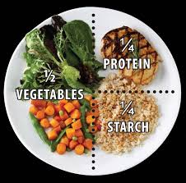
Next Steps
Meal Planning
Grocery Shopping-stocking pantry, fridge, freezer
Healthy Cooking

Slide 20
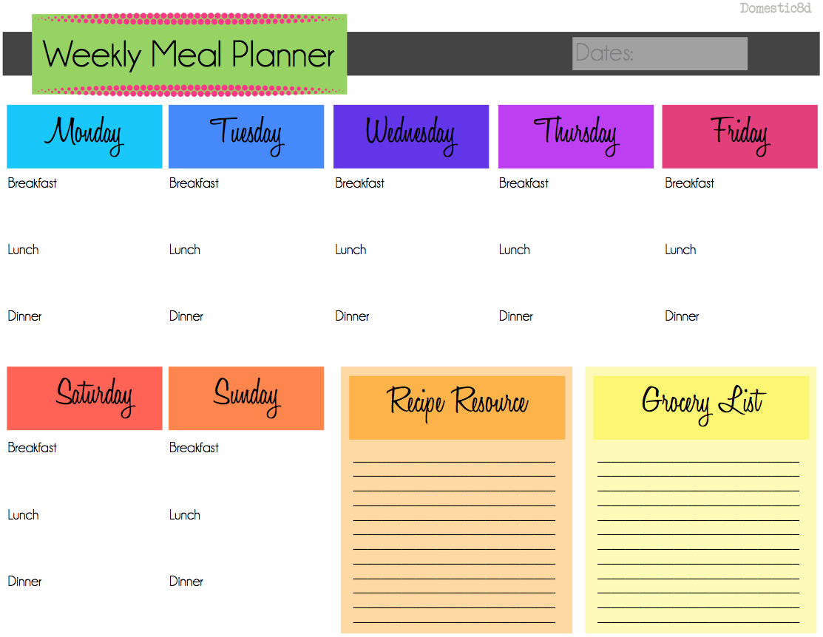
Have a Plan for Healthy Eating
Meal Planning:
  Saves time
  Saves money
  Improves nutrition
  Rely less on fast foods, convenience foods.

Slide 21
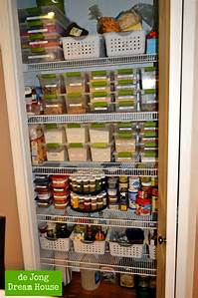
Foods to Buy-Stocking your
Pantry
Whole Grains: oatmeal, whole wheat pasta, barley, quinoa, whole grain couscous, brown rice, whole grain bread crumbs, whole grain and low sugar cereals
Beans (canned or dried) and lentils
Nuts, seeds (includes nut butters)
Canned, reduced sodium fish tuna, salmon
Canned, no salt added vegetables
Canned, no sugar added fruits
Dried fruits with no added sugars
Olive and canola oils or other nut oils like walnut, peanut, sesame seed
Vinegars (balsamic, rice, wine etc.)
Herbs, spices and garlic/onions
Low sodium stocks

Slide 22
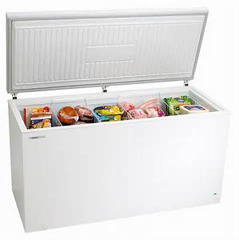
Foods to Buy-Stocking your
Freezer
Vegetables with no salts/fats added
Fruits with no sugars added
Fish
Skinless Chicken
Ground turkey (lean-look for 93% or higher)
Lean ground beef (93% or higher)
leftovers

Slide 23
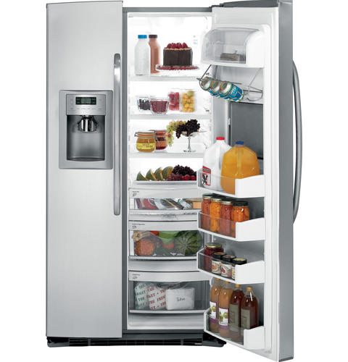
Foods to Buy-Stocking Your
Fridge
Fresh fruits and vegetables
Eggs
Skim or 1% milk
Low fat cheeses
Low fat yogurts
Low fat cottage cheeses
Healthy salad dressings
Tofu
Lean deli meats

Slide 24

Cooking Safe:
Remember healthy eating starts with cooking safe!
  Use good foods safety practices
  Check expiration dates
  Learn proper cooking temps
  Avoid danger zone (40-140 degrees)
  Avoid cross contamination
  Thaw meats properly
  Use good knife skills
  Wash hands

Slide 25
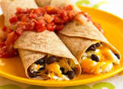
Increase Whole Grains at:
Breakfast:
  Cereals (cheerios, oatmeal etc.)
  Whole grain English muffins, breads, tortillas
  Whole grain flours for pancakes/waffles etc.
Lunch/Dinner:
  100% whole grain breads, wraps, brown rice, whole wheat pasta, quinoa etc.
Snacks:
  Whole grain crackers (Triscuits), low fat popcorn, whole grain breads, whole grain snack bars (Kashi).

Slide 26
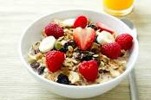
Increase Fruits and Veggies at:
Breakfast:
  add fruit to cereal, plain yogurt or oatmeal.
  Top peanut butter toast or whole grain waffles/pancakes with fruit.
  Include in smoothies (fruits/veggies).
  Add veggies to scrambled eggs.
Lunch/Dinner:
  Include in wraps and sandwiches.
  Make whole grain salads with fresh veggies.
  Chef salads/garden salads with grilled chicken.
  Add to soups or casseroles.
  Steam, roast or grill for side dishes.
Snacks:
  Fresh veggies with low fat- yogurt dip or hummus.
  Fresh fruits/veggies with low fat cheese or peanut butter.
  Add fruit to plain yogurt.
  Make smoothies

Slide 27
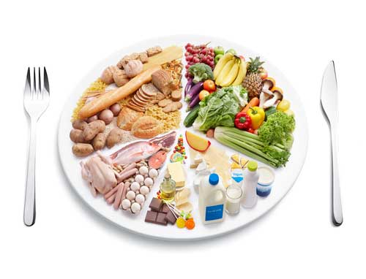
Decrease Saturated Fats at:
Breakfast:
  Use non-stick cooking spray for eggs.
  Use egg whites instead of whole eggs.
  Use lean breakfast meats: turkey bacon/sausage, Canadian bacon, ham
  Use low fat, plain yogurts.
  1%/skim milks.
  Heart healthy spreads/margarines like Smart balance/Promise.
Lunch/Dinner:
  eat beans, lean meats, poultry or fish instead of higher fat ones.
  Grill, bake or roast instead of fry.
  Use tomato based sauces instead of cream based ones.
  Use reduced fat cheeses.
  Limit high fat condiments: ranch dressings , sour cream or other sauces.
  Eat out less!
Snacks:
  more fruits and veggies!
  Less chips
  Unsalted nuts/seeds.

Slide 28
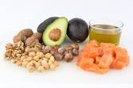
Increase Good Fats at:
Breakfast:
  Add nuts/seeds to cereals or oatmeal.
  Use avocado in smoothies or on eggs.
  Add fish to breakfast.
Lunch/Dinner:
  Include more fish (tuna/salmon)
  Use olive or canola oils to sauté
  Use oil based salad dressings.
  Add nuts to salads, pasta dishes or stir fry’s.
Snacks:
  Nuts/nut butters.
  Guacamole and veggies
  Low fat tuna salad with veggie sticks.
  Hummus with veggies.

Slide 29
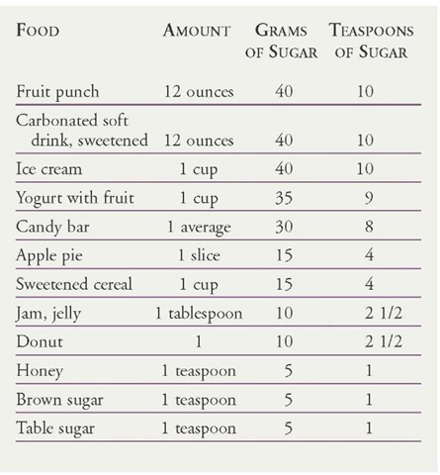
Lower Sugars at:
Breakfast:
  Use low sugar cereals, breakfast bars and plain yogurts.
  Use fruit instead of syrup for pancakes/waffles.
  Eat fruit instead of drink juice.
  Use unsweetened milks.
Lunch/Dinner:
  Have more fruit for dessert.
  Limit sweet sauces.
  Drink water instead of soda or other sweet drinks.
Snacks:
  Eat more fruits/veggies.
  Check labels of snack foods and switch out for products with lower numbers.
  Drink water!

Slide 30
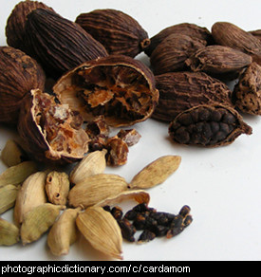
Lower Sodium at:
Breakfast:
  Add pepper, Mrs. Dash to eggs/potatoes instead of salt.
  Use lower sodium breakfast meats.
  Check breads/pastries/biscuits (these can carry a lot of sodium).
Lunch/Dinner:
  Rinse canned foods.
  Limit added salt: instead use other flavor enhancers.
  Limit sauces, condiments, ketchup etc.
  Limit fast foods/frozen foods.
  Use lower sodium deli meats and cheeses.
Snacks:
  Use unsalted nuts
  More fruits/veggies
  Eat Low fat, low sugar yogurt
  Reduced sodium crackers, popcorn etc.

Slide 31
Flavor Enhancers
Herbs (fresh/dried)
Spices
Mrs. Dash
Vinegars
Fruit-juice: citrus, pineapple, apple
Extracts: vanilla, almond, lemon etc.
Garlic powder or fresh garlic, onion or onion powder (not salts)
Lower sodium condiments: soy sauces, Mrs. Dash Marinades etc.
Oils: walnut, sesame seed, pumpkin etc.
Cooking Methods like: roasting, toasting, grilling etc.

Slide 32
Links to Healthy Recipes
Cooking Matters
Cooking Light
American Heart Association
American Diabetes Association
MyPlate.gov

Slide 33
Today’s Recipe
Fall Vegetable Salad- Cooking Matters
Website: https://cookingmatters.org/recipes/fall-vegetable-salad
Lifestyle Medicine and CHC currently host CM classes for families☺
Great resource for families in the community.

Slide 34
Fall Vegetable Salad
Serves 8 (1 cup serving)
INGREDIENTS:
1 cup barley, whole grain couscous, or quinoa
1 medium bulb fennel
1 bunch hearty greens, such as kale, chard, collard greens or beet greens
1 small beet
1 medium, firm apple
1 clove garlic
½ cup nuts or seeds, such as pecans, almonds or walnuts
1 medium lemon
¼ cup cider vinegar
1 tablespoon Dijon Mustard
¼ cup canola oil
¼ teaspoon salt
¼ teaspoon ground black pepper
Optional: 2 oz. cheese, such as blue, goat or cheddar cheese
INSTRUCTIONS:
Cook grains according to package directions. Transfer to a large bowl. Prepare rest of salad while you let grains cool completely.
Rinse fennel, greens, beet and apple.
Cut any long stalks and fronds off fennel. Quarter fennel and cut out core. Slice thinly.
Remove stems from greens. Stack leaves together, roll into a thick, log and slice thinly.
Peel and cut beet into ¼ inch cubes. Cut apple into ¼ inch cubes.
Pell and mince garlic.
If using, crumble cheese or cut into ¼ inch cubes.
In a small skillet over medium heat, toast nuts. Cook until fragrant 3-5 minutes.
Rinse and cut lemon in half. In a small bowl, squeeze juice, discard any seeds.
Add vinegar, minced garlic and mustard to lemon juice. Whisk with a fork to combine. While whisking, slowly drizzle in oil. Season with salt and pepper.
When grains are cool, add fennel, greens, beet and apple. Drizzle with dressing and toss to combine. Sprinkle with the toasted nuts and cheese if using.

Slide 35
Thank You!!

